Slide 1
Security and Compliance Planning

Slide 2
IAM
IAM stands for Identity Access Management.
AWS Identity and Access Management (IAM) is a service that helps you securely control access to AWS resources.
IAM allows you to manage users and their level of access to the aws console.
It is used to set users, permissions and roles. It allows you to grant access to the different parts of the AWS platform.
IAM identities can be classified as IAM users, IAM groups, IAM roles.
IAM is a critical service for securing your AWS environment, and understanding how to manage access effectively is vital for ensuring both security and functionality.

Slide 3
S3
S3 is Simple Storage Service
Amazon S3 is a Simple Storage Service in AWS that stores files of different types like Photos, Audio, and Videos as Objects providing more scalability and security to.
It allows the users to store and retrieve any amount of data at any point in time from anywhere on the web.
Data, in S3, is stored in containers called buckets. This enables users to have more control over their data.
S3 is a powerful and flexible storage solution, ideal for a variety of use cases ranging from simple file storage to large-scale data lakes.

Slide 4
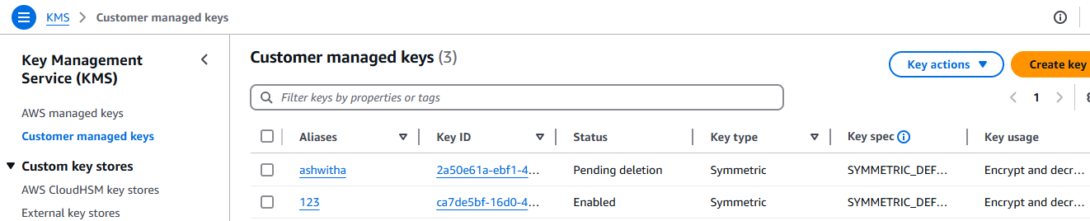
KMS
AWS KMS is a managed service that makes it easy for you to create, control, and use the encryption keys across all AWS services and in your applications.
It enables you to protect the data encryption process while maintaining control over the encryption keys.

Slide 5
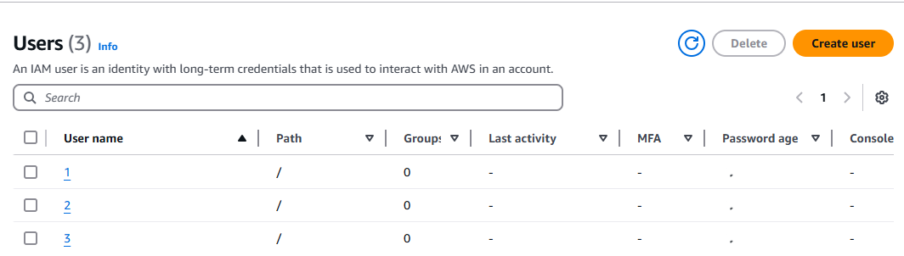
Steps:
Firstly, created three users in IAM.
While creating the users give the s3 full access in the permission policies

Slide 6
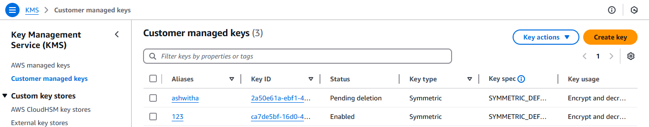
Then, in the KMS create keys, while creating the keys name the key and then in the key administrators choose the user to add the additional permissions for the users; also select the IAM users that can use KMS key.

Slide 7
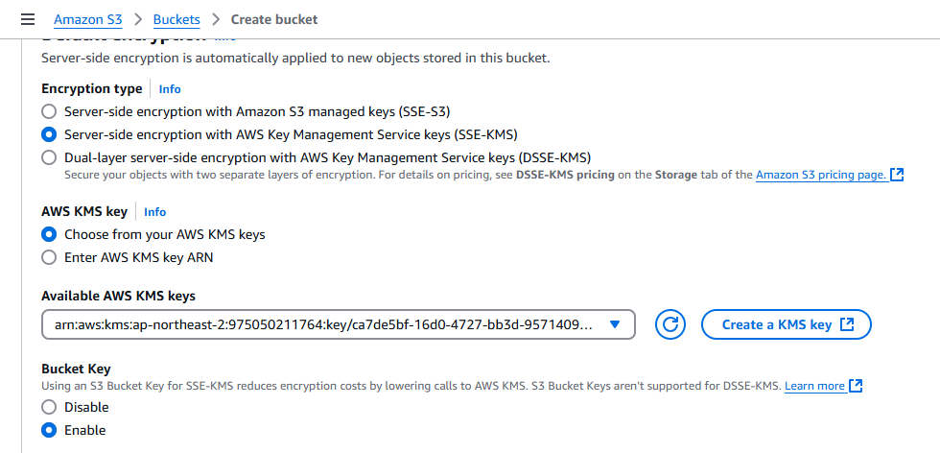
Create s3 bucket in the root user choose as shown in the screenshot below to select the KMS key while creating the bucket.

Slide 8
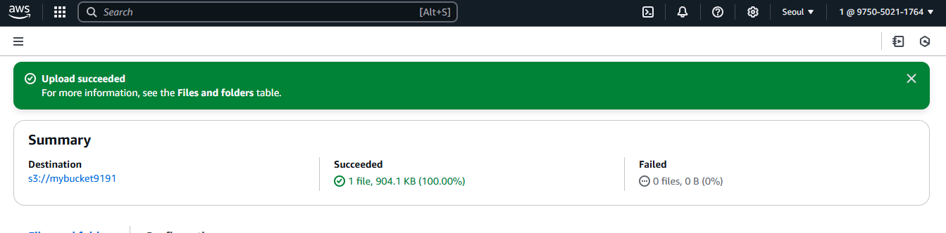
Sign in to any of the users among three created, after creating the KMS key and creating the buckets. Upload the object in the user to confirm. The files get uploaded in the bucket. The files are uploaded as shown in the picture below in the user named as 1; the files get uploaded in the user where the user is chosen while creating KMS.

Slide 9
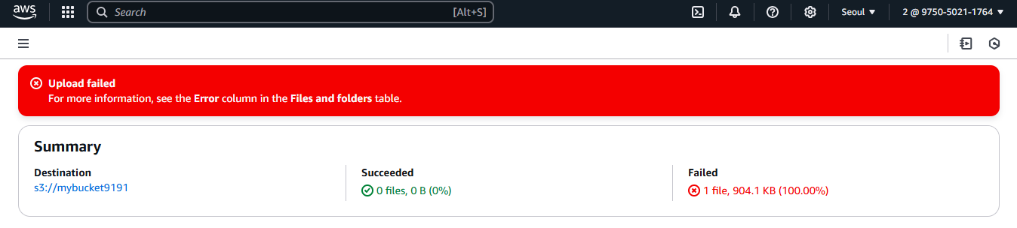
The files cannot be uploaded in the other users as in the KMS while creating the key the other users are not chosen in the key administrators and key users, as kms allows to upload files in the users chosen. In the below shown picture in the user named as 2 the files were failed to upload, as the user is not chosen while creating KMS

Slide 10
THANKYOU

